Slide 1
Form Control
Parker Zhou
parkerzho2010@gmail.com

Slide 2
Topic
HTTP
Form
Traditional Form Control
New Form Control
Form submission
Form Validation
Form Validation with js

Slide 3
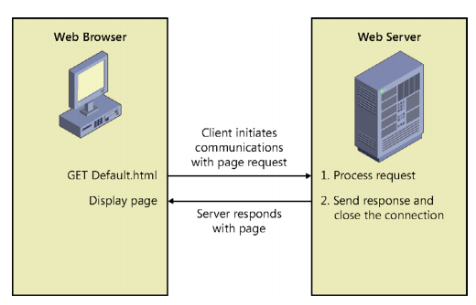
HTTP
Notes:
1. The user browses to a website, which causes the browser to initiate a request for a web
server resource.
2. HTTP protocol sends a GET request to the web server.
3. The web server processes the request.
4. The web server sends a response to the web browser, also by using HTTP protocol.
5. The browser processes the response, causing a webpage to display.

Slide 4
Form
You can use the HTML <form> element to create a web form that collects data and sends the data to the web server
<form method="post" action="getCustomer.aspx" >
Enter Customer ID:
<input type="text" name="Id" />
<input type="submit" value="Get Customer" />
</form>

Slide 5
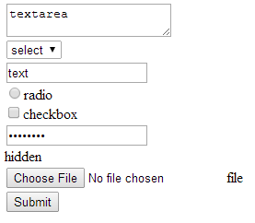
Traditional Form Control
<textarea row=“5”></textarea>
<select><option value=“1”>
<input type=’text’>
<input type=’radio’>
<input type=’checkbox’>
<input type=’password’>
<input type=’hidden’>
<input type=’file’>
<input type=’submit’>

Slide 6
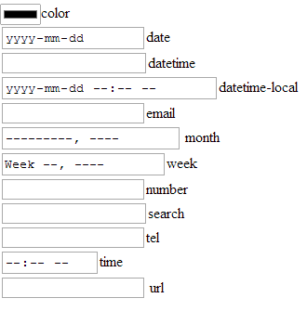
New Form Control
<input type='color‘ value=“”>
<input type='date'>
<input type='datetime'>
<input type='datetime-local'>
<input type='email'>
<input type='month'>
<input type='week'>
<input type='number'>
<input type='search'>
<input type='tel'>
<input type='time'>
<input type='url'>
<input type='range'>
Notes:
<form method="post" action="getCustomer.aspx" >
<input type='color'>color<br/>
<input type='date'>date<br/>
<input type='datetime'>datetime<br/>
<input type='datetime-local'>datetime-local<br/>
<input type='email'>email<br/>
<input type='month'> month<br/>
<input type='week'>week<br/>
<input type='number'>number <br/>
<input type='search'>search <br/>
<input type='tel'>tel<br/>
<input type='time'>time <br/>
<input type='url'> url<br/>
</form>

Slide 7
Form submission
Triggering the form submission causes the browser to gather its associated form submission element data and send it to the URI specified in the action attribute of the form, using the form’s specified HTTP method.
Two way to submit
User click <input type=“submit”/>
Use javascript : $('#myForm').submit();

Slide 8
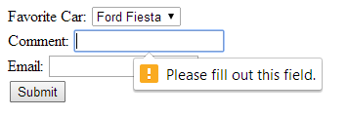
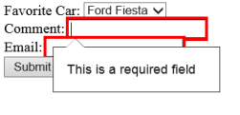
Form Validation
<form id="myForm">
Favorite Car:
<select name="favoriteCar" required="required">
<option>Ford Fiesta</option>
<option value="Chevy">Chevrolet</option>
<option>BMW</option>
</select><br />
Comment:
<input type="text" name="comment" required="required" /><br />
Email:
<input type="email" name="email" required="required" /><br />
<button type="submit" name="submit">Submit</button>
</form>
In Chrome
In IE

Slide 9
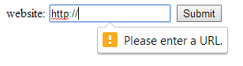
Form Validation
<form id="myForm">
website:
<input type="url" name="website"
required="required" pattern="https?://.+" />
<button type="submit" name="submit">Submit</button>
</form>

Slide 10
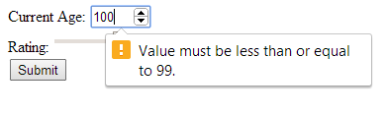
Form Validation
<form id="myForm">
Current Age:
<input type="number" name="age"
min="18" max="99" value="30"
required="required" /><br />
Rating:
<input type="range" name="rating"
min="1" max="7" value="4" /><br />
<button type="submit" name="submit">Submit</button>
</form>

Slide 11
Form Validation with js
myField.addEventListener("invalid", invalidHandler, false);
function invalidHandler(evt){
var validity = evt.srcElement.validity;
if (validity.valueMissing){
…
}
}

Slide 12
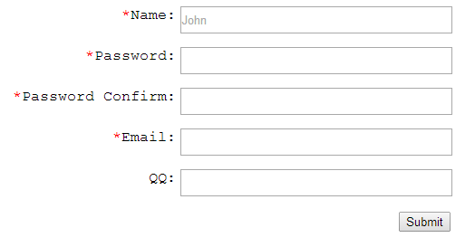
Exercise
Style the form
Use form validation
Use js to check if password and password confirm are matched
Notes:
<style type="text/css">
body{
font-family: 'Arail',monospace;
}
.form-row {
margin-top: 5px;
padding:5px;
width: 600px;
}
.form-row:after{
content: " ";
display: block;
clear: both;
visibility: hidden;
height: 0px;
}
.form-row label:last-child {
display: block;
width: 200px;
text-align: right;
margin-right:5px;
float: right;
}
.form-row input{
display: block;
float: right;
}
.form-row input[type="text"]
,.form-row input[type="password"]
,.form-row input[type="email"] {
height: 30px;
width: 300px;
}
.form-row input[required] + label:before {
content: "*";
color: red;
}
</style>
<form id="myForm">
<div class="form-row">
<input type="text" required="required" name="name" placeholder="John">
<label>Name:</label>
</div>
<div class="form-row">
<input type="password" required="required" name="password"/>
<label>Password:</label>
</div>
<div class="form-row">
<input type="password" required="required" name="password_confirm"/>
<label>Password Comfirm:</label>
</div>
<div class="form-row">
<input type="password" required="required" name="email" pattern=".+@.+" />
<label>Email:</label>
</div>
<div class="form-row">
<input type="text" name="qq" pattern="\d+" />
<label>QQ:</label>
</div>
<div class="form-row">
<label>&nbsp;</label>
<input type="submit" value="submit"/>
</div>
</form>

